Slide 1
Antimicrobial Stewardship:
ID in Seconds
Matthew B. Goetz, MD; Chris Graber, MD, MPH; Simon Wu, MD
VA Greater Los Angeles Healthcare System
David Geffen School of Medicine at UCLA, Los Angeles, CA

Slide 2
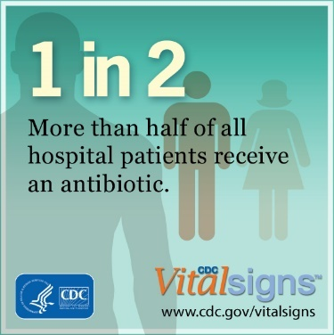
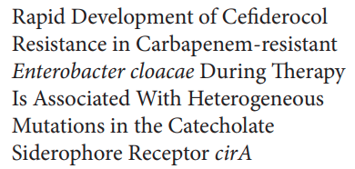
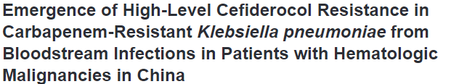
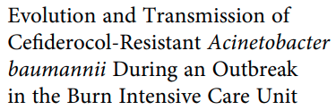
Why do we care about Antimicrobial
Stewardship?
Up to 50% of hospitalized patients get antibiotics
  ~50% of US inpt & outpt antibiotic use is inappropriate/suboptimal
  30% entirely unnecessary
Consequences of antibiotic use
  Short-term: adverse events, patient & societal C. difficile – up to 20% of hosp. pts who get an antibiotic have an ADE from that agent
  Long-term: microbiome disruption, patient & pop.-level resistance
Limited development of new antimicrobials
  No new antibacterials since cefiderocol in 2019
Microbiology Spectrum. 2022 https://doi.org/10.1128/spectrum.00084-22
Clin Infect Dis. 2023;76(3):e1261–e5
Clin Infect Dis. 2022;74(5):905-908
Fridkin S, et al. MMWR. 2014; 63(09):194-200. Dellit TH et al. Clin Infect Dis 2007; 44:159–77.

Slide 3
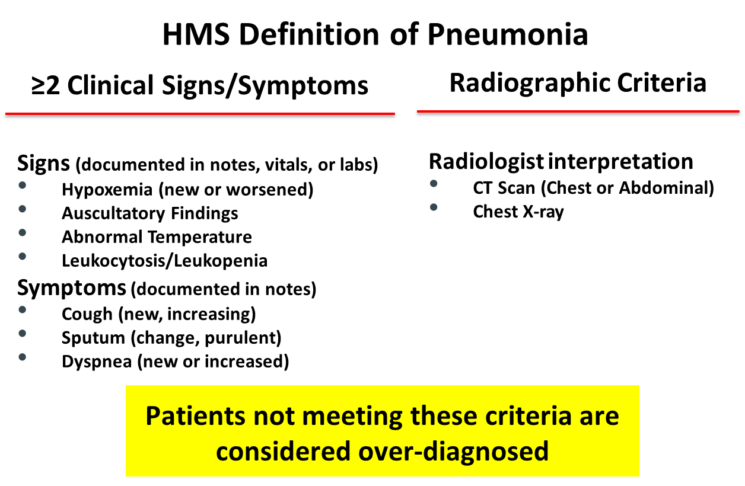
Avoid Overdiagnosing Pneumonia
National Quality Forum Definition of Pneumonia
≥2 Clinical Signs/Symptoms AND Radiographic Criteria
Frequency of Overdiagnosis
Michigan – 46 hospitals
11.4% of 14,085 CAP pts were overdiagnosed
Boston – 4 hospitals
All clinical signs for pneumonia were normal for 18.7% of treated CAP patients
Consequences of Overdiagnosis
Discrepancy between admitting and discharge diagnosis associated with
  Longer length of stay
  Increased inpatient mortality, ICU admission, 30-day readmission.
Gupta et al. BMJ Qual Saf. 2022 May;31(5):383-386.
Klompas M, et al. JAMA Network Open. 2020;3(7):e2010700.
National Quality Forum: https://nqfappservicesstorage.blob.core.windows.net/proddocs/27/Spring/2022/measures/3671/shared/3671.zip
Newman-Toker DE et al..
Diagnosis. 2020 May 14;8(1):67-84.
Johnson. J Hosp Med. 2009 Apr;4(4):234-9
Zikos. JAMIA. 2019
Notes:
Among patients overdiagnosed with CAP, antibiotics were started by EM clinicians in 76.1% (n=885/1163) of cases, respectively
Endorsed by the National Quality Forum https://nqfappservicesstorage.blob.core.windows.net/proddocs/27/Spring/2022/measures/3671/shared/3671.zip
Imaging findgs acceptable in HMS
Air space density/opacity/disease, consolidation, infiltrate
Aspiration/aspiration pneumonia
Abscess, cavitation, loculations
Pneumonia, infection
Ground glass, nodular airspace disease
“cannot rule out pneumonia”

Slide 4
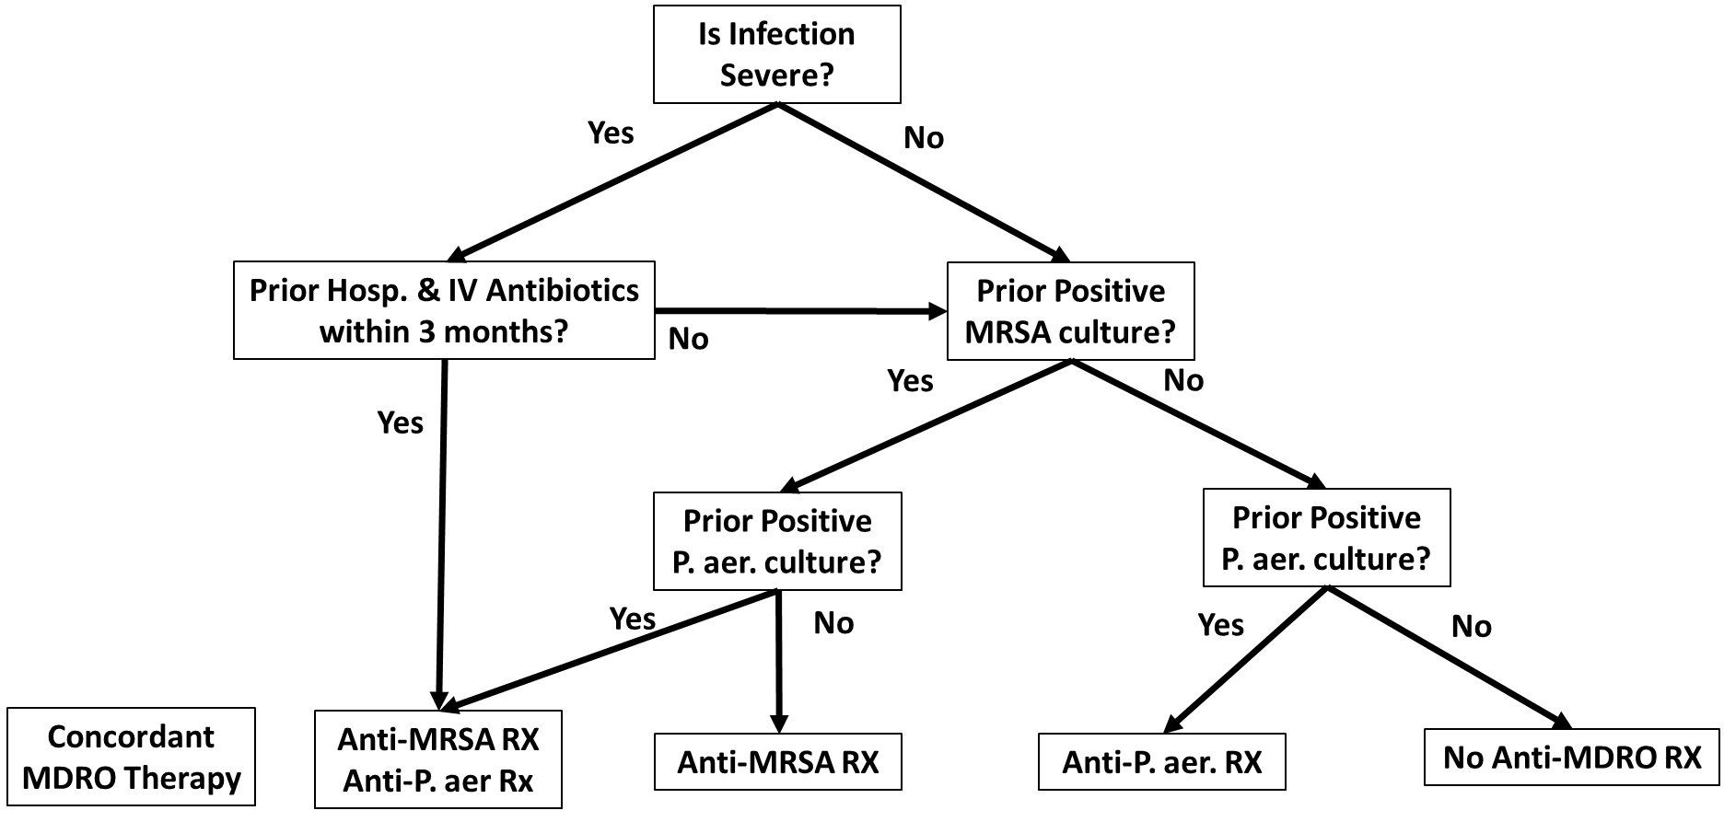
CAP: When Should Empiric Anti-MRSA or Anti-Pseudomonal Therapy be Given?
Note: Prior IV antibiotics & recent hospitalization is a proxy for locally validated risk factors
Severe pneumonia definition:
  Any of
    Septic shock (pressors)
    Respiratory failure (mech vent
  Or presence of 3 minor criteria
    Respiratory Rate ≥ 30
    PaO₂/FIO₂ ≤ 250 ( > ~2 L nasal O₂)
    Multi-lobar infiltrates
    New confusion/disorientation
    New BUN ≥ 20
    WBC < 4,000
    Platelets < 100,000
    Core T < 36°
    ⬇ BP requiring aggressive fluids
Metlay J, et al. Diagnosis and Treatment of Adults with Community-acquired Pneumonia. Am J Respir Crit Care Med . 2019; 200:e45–e67.

Slide 5
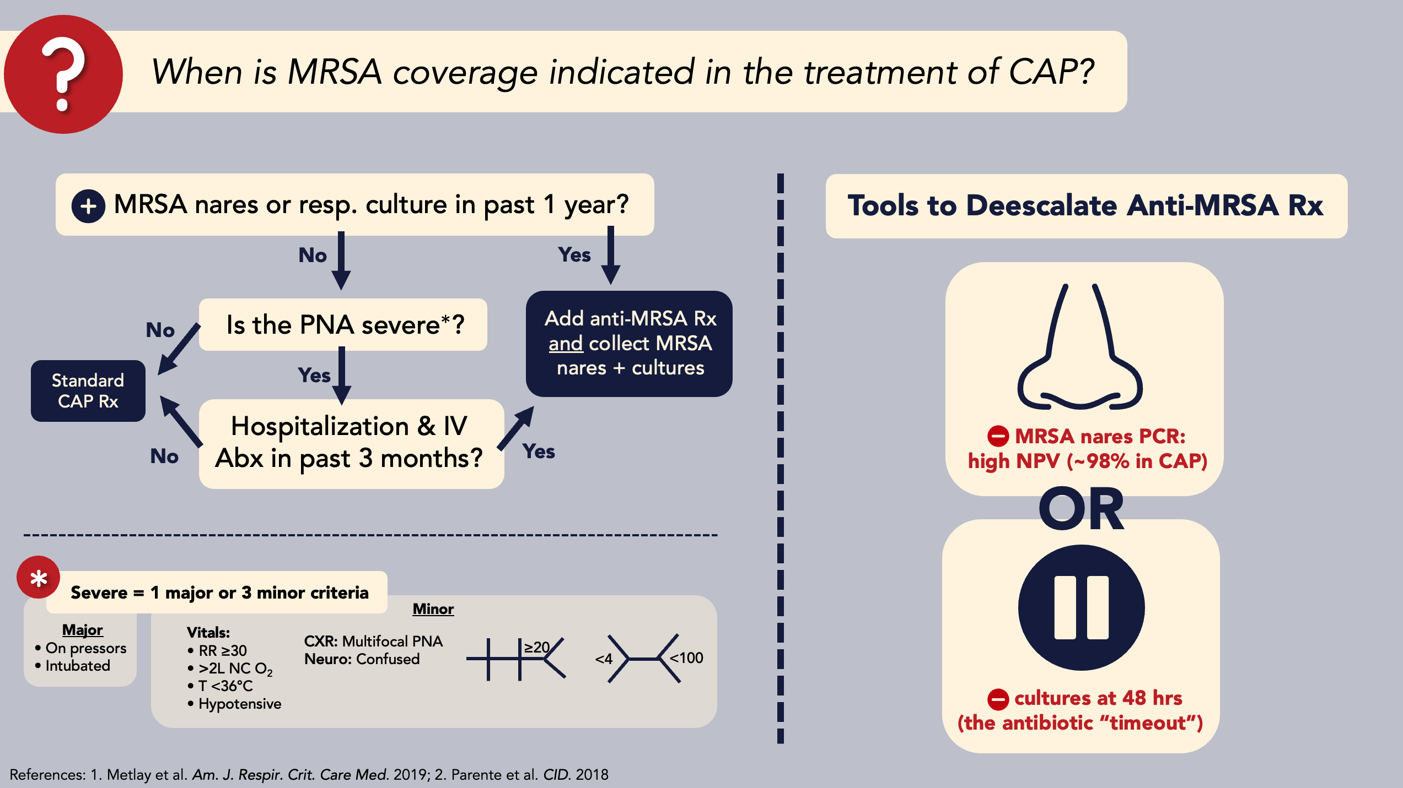

Slide 6
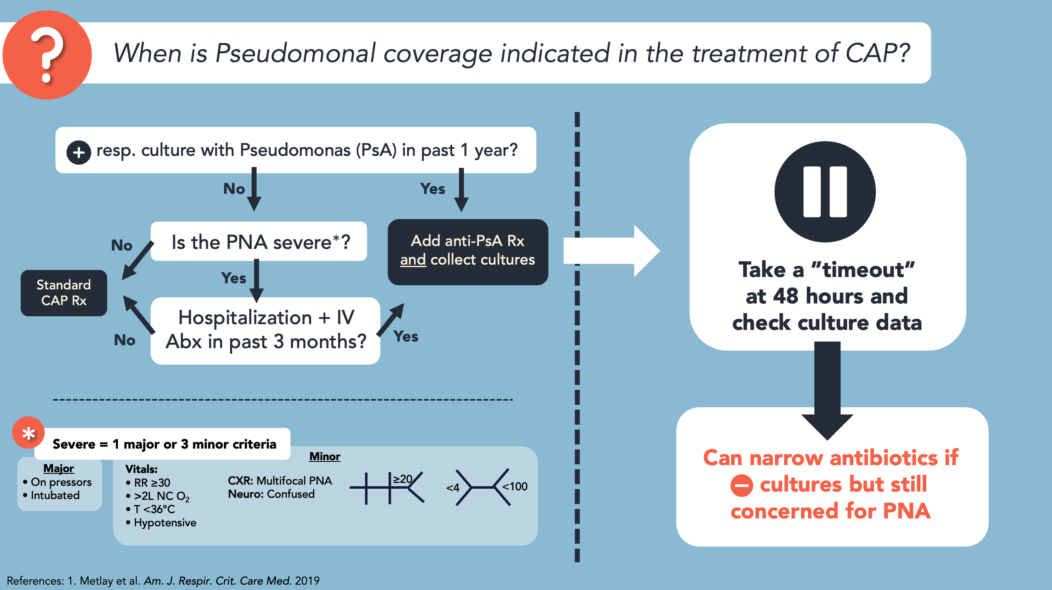

Slide 7
When is Anaerobic Coverage Indicated in the Treatment of Pneumonia?

Slide 8
Aspiration Pneumonitis vs Aspiration Pneumonia
Aspiration Pneumonitis
Develops immediately after an aspiration event
Clinical recovery within 24-48 hours
A subset develops ARDS
No benefit from antibiotics
Aspiration Pneumonia
Takes 3-5 days to develop after aspiration event
Specific anti-anaerobic therapy necessary only with empyema, lung abscess, necrotizing pneumonia
Metlay J, et al. Diagnosis and Treatment of Adults with Community-acquired Pneumonia. Am J Respir Crit Care Med . 2019; 200:e45–e67.

Slide 9
CAP: What is the Appropriate Duration of Therapy?
Non-ICU VA CAP Patients
99% are clinically stable by day 5
42.7% receive ≥ 7 days of antibiotics
  18.7% receive ≥ 8 days of antibiotics
Appropriate duration: ≥ 5 days and ≤1 day after achievement of stability
Appropriate duration: guided by time to achieve clinical stability
  At least ≥ 5 days
  No more than one day after achievement of clinical stability
  Minimum of 7 days for pneumonia due to S. aureus or P. aeruginosa
  Exclusions: Lung abscess, empyema, infection due to fungi, mycobacteria, Legionella
.
Metlay J, et al. Diagnosis and Treatment of Adults with Community-acquired Pneumonia. Am J Respir Crit Care Med . 2019; 200:e45–e67.
Notes:
As shown on this slide, the criteria for persons receiving 5 days or more of antibacterial therapy are consistent with the ATS/IDSA guidelines.
Thus we believe the tier assignments for this group of patients should not be controversial – QUESTIONS?

Slide 10
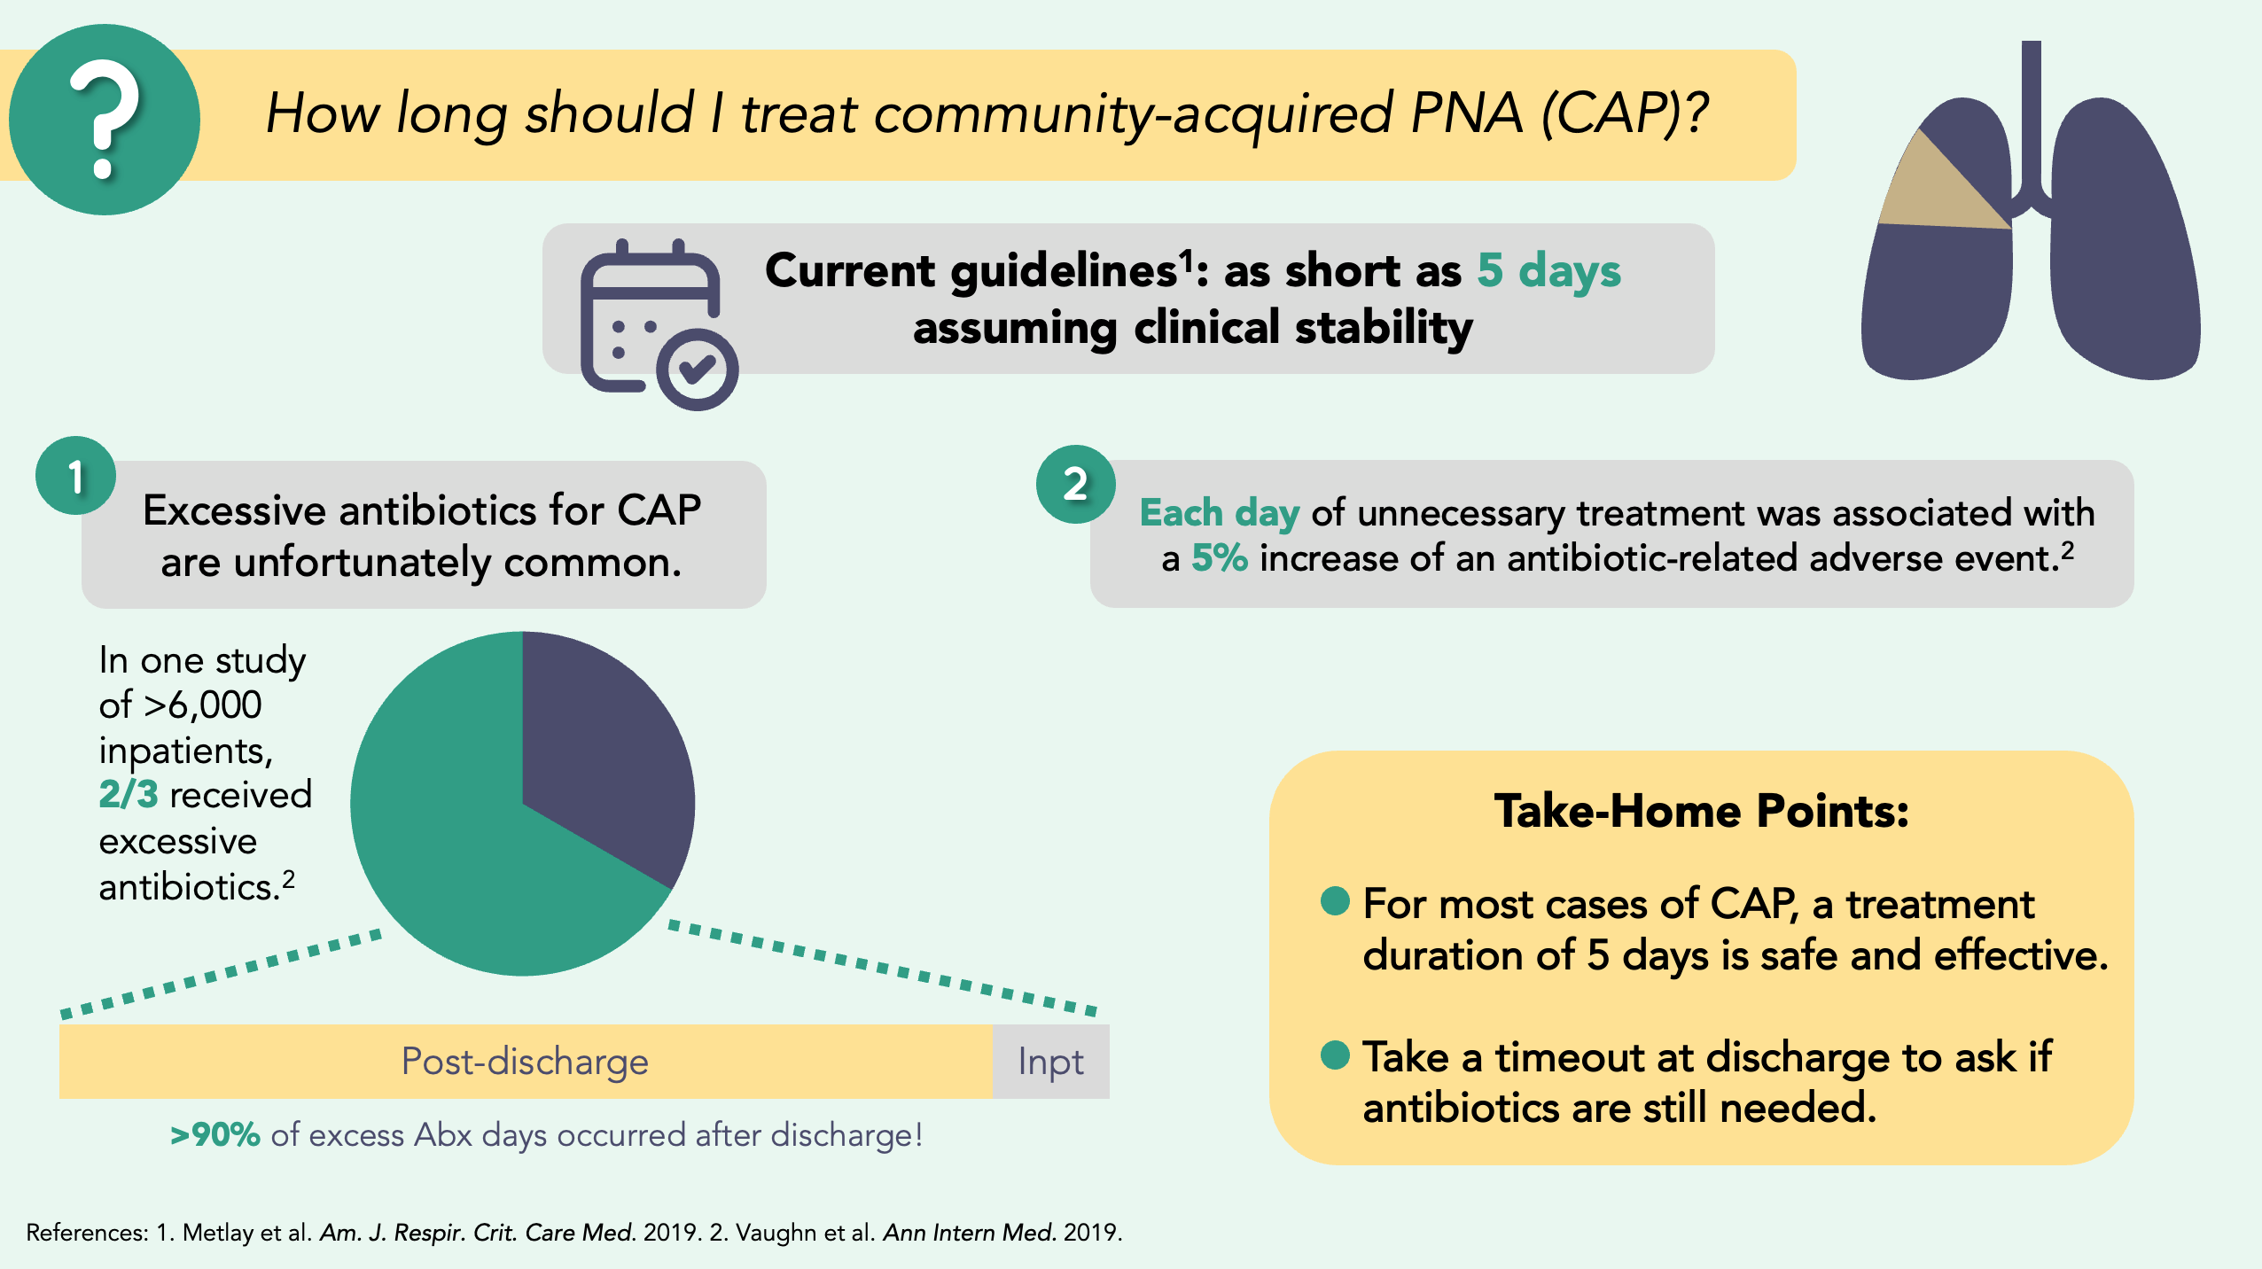

Slide 11
  What is the appropriate duration of therapy for persons with viral pneumonia?
ATS/IDSA: 2019 CAP guidelines
  Antibiotic therapy should be continued until the patient achieves stability and for no less than a total of 5 days
  Influenza if no evidence of bacterial infection & clinically stable, “consideration could be given to earlier discontinuation of antibiotic treatment at 48 to 72 hours.”
NIH COVID GL: “antibiotic use should be reassessed daily.”
  Multiple studies show no benefit of antibiotics for COVID pneumonia
Two RCTs have demonstrated non-inferiority of 3 vs 8 days of therapy for clinically stable non-immunosuppressed patients.
Draft ATS/IDSA CP GL: To be determined….
Metlay JP et al.. Am J Respir Crit Care Med. 2019; 200:e45-e67. el Moussaoui R, et al. BMJ. 2006;332(7554):1355. Dinh A, et al. Lancet. 2021;397(10280):1195-203. https://files.covid19treatmentguidelines.nih.gov/guidelines/covid19treatmentguidelines.pdf accessed 4/21/2013.
Notes:
What is the appropriate duration of therapy for persons with viral pneumonia?
READ the SLIDE
In addition, we believe that it is relevant that
The EPIC study found that a bacterial pathogen was identified in only 11% of 1777 patients not receiving ICU-level care, in contrast a viral pathogen was identified in 24% of these patients while no pathogen could be detected in 64% of patients.
Antibiotics are often initiated in patients who have low evidence for having community-acquired pneumonia. For example, in a recent study possible community-acquired pneumonia, all clinical signs associated with pneumonia were normal for 18.7% of 9540 patients who received antibiotic therapy. (7)
Pause for questions
---
ATS/IDSA 2019
“As recent data supporting antibiotic administration for <5 days are scant, on a risk–benefit basis we recommend treating for a minimum of 5 days, even if the patient has reached clinical stability before 5 days.”
Metlay JP et al.. Am J Respir Crit Care Med. 2019; 200:e45-e67.

Slide 12

Avoid Overdiagnosing Urinary Tract Infections
Definition of Urinary Tract Infection
Positive urine culture plus any:
Signs
  Suprapubic/Costovertebral tenderness
  Acute hematuria
  Fever
Symptoms
  Dysuria
  Urinary Frequency/Urgency
  Suprapubic/costovertebral Pain
New onset mental status change with:
  ⬆ WBC, hypotension or ≥2 SIRS criteria
Spinal cord injury patients only
  ⬆ spasticity, autonomic dysreflexia
Frequency of Overdiagnosis
Michigan – 46 hospitals
  83% of asymptomatic bacteriuria (ASB) pts received 7 days of antibiotics
  Rx a/w ⬆ LOS, adverse events
VA 25 hospitals
  57% of ASB pts with received 10 days of antibiotics for that indication only
Prevalence of Pyuria
  Young women 32%
  Diabetic women 70%
  New catheter 30-75%
  Chronic catheter 50-100%
  ESRF 90%
  LTCF 90%
UTI
ASB
Nicolle LE, et al. Clin. Infect Dis. 2019; 68:1611-1615
Hooton TM et al, Clin. Infect Dis. 2010;50:625.
Petty LA et al. JAMA Int Med. 2019; 179:1519-1527.
Spivak ES et al.. Clin Infect Dis. 2017; 65:910=917

Slide 13
Duration and Dosing of Therapy for UTI
Duration of Therapy
Non-catheterized women:
  Uncomplicated cystitis: 3 – 7 days
  Pyelonephritis: 7 days fluoroquinolone, 10-14 days other
Men: duration of therapy ill defined
  Outpatient pyelonephritis RCT: Similar success with 7 vs 14 days of therapy
Bacteremic UTI with source control & clinical stability by day 5
  7 days of therapy equivalent to 14
  Must assure use of appropriate doses of oral antibiotic agents
Dosing of Oral Antibiotics for UTI
 | Usual UTI |  | Bacteremic UTI
Antibiotic | Dose (mg) | Dosing | Dose (mg) | Dosing
Amoxicillin | 500 | q8 h | 1000 | q8 h
Amox/Clav | 875/125 | q12 h | 875/125 | q8 h
Cephalexin | 500 | q8 - 12 h | 1000 | q6 h
TMP-SMX | 160/800 | q12 h | 320/1600 | q12 h
Ciprofloxacin | 500 | q12 h | 750 | q12 h
Levofloxacin | 500 | qd | 750 | qd
Cefadroxil* | 500 | q12 h | 1000 | q12 h
Cefpodoxime* | 100 - 200 | q12 h | 400 | q12 h
Cefdinir* | 300 | q12 h | 600 | q12 h
* Lack robust PK data, not recommended for routine use in bacteremic patients
Gupta K, et al. IDSA UTI guidelines in Women. Clin Infect Dis. 2011;52(5):e103–e120. Drekonja DM, et al. JAMA Intern Med 2013; 173(1):62-68. Drekonja DM, et al. JAMA 2021;326(4):324-31. Yahav D, et al. Clin Infect Dis 2019;69(7):1091-8. Heil E, et al. Open Forum Infect Dis. 2021;8:ofab434
Notes:
prefer cephalexin because its
susceptibility can more feasibly be approximated compared with
that of cefazolin in blood isolates (MIC 2 mg/L) for institutions
that rely on automated susceptibility panels

Slide 14
Gram-Negative Bacteremia
7 vs 14 Days of Therapy
Open-label, randomized trial, hosp adults with GNR +BC
  7 vs 14 days of Rx in pts afebrile & hemodynamically stable for 48 hrs
  Composite primary outcome: 90-day mortality, relapse & readmission
  When switching to oral agents, use high dose or highly available oral antibiotics
Characteristic / Outcome* | 7 days (n=306) | 14 days (n=298) | P
Age | 71 (62-81) | 71
Immunosuppression | 69 (22%) | 81 (27%)
Nosocomial infection | 81 (2%) | 95 (32%)
Partial oral Rx | 110 (36%) | 56 (19%)
Primary outcome | 40 (46%) | 144 (48%) | 0.53
90 day mortality | 36 (12%) | 32 (11%) | 0.70
28 day mortality | 15 (4.9%) | 13 (4.4%) | 0.75
Relapse | 8 (3%) | 8 (3%) | 0.96
Readmission | 119 (39%) | 127 (43%) | 0.36
30-day assistance in ADL | 150 (51%) | 163 (57%) | 0.03
Yahev D, et al. Clin Infect Dis. 201969:1091-1098.. Heil E, et al. Open Forum Infect Dis. 2021;8:ofab434. Similar results in Chotiprasitsakul D, et al.. Clin Infect Dis. 2018; 66:172-7.
Notes:
The decision on timing of switch to oral antibiotic therapy as well as time of discharge was also left to the discretion of the treating physician
Clinical Infectious Diseases, ciy1054, https://doi.org/10.1093/cid/ciy1054
If completing with oral agents, use high dose or highly available oral antibiotics

Slide 15
Gram-Positive Cocci in Blood Cultures
Using BioFire (BCID) to Rapidly Identify MRSA
SCCmec
(gene cassette that carries mecA/C: the gene responsible for methicillin resistance)
Primers specific to S. aureus
Primers common to all staphylo-cocci
mecA/C
(methicillin resistance gene*)
MREJ
(junction of SCCmec and S. aureus genome)
Only MRSA will have both mecA/C + MREJ!

Slide 16


MRSA vs MSSA
mecA/C + MREJ
MRSA
Staph
&
S. aureus
mecA/C + MREJ
MSSA
MR vs MS S. epi & S. lug
Methicillin-resistant S. epidermidis/
S. lugdenensis
mecA/C
Staph
&
S. epi /
S. lug
mecA/C
Methicillin-sensitive S. epidermidis/
S. lugdenensis
Other Coag-neg Staph
S. aureus
Staph
&
(BCID2 will not report mecA/C results in this case)
Other CONS (assume methicillin resistance)
S. epi /
S. lug

Slide 18


For every 100 hospitalized ward patients in Michigan with asymptomatic bacteriuria and altered mental status…
Less than 1 (0.7%) were bacteremic within 72 hours
Factors associated with highest risk of bacteremia: hypotension, 2 or more SIRS criteria, systemic leukocytosis, UA WBC >25
Advani SD, et al. JAMA Network Open 2024;7(3):e242283

Slide 20
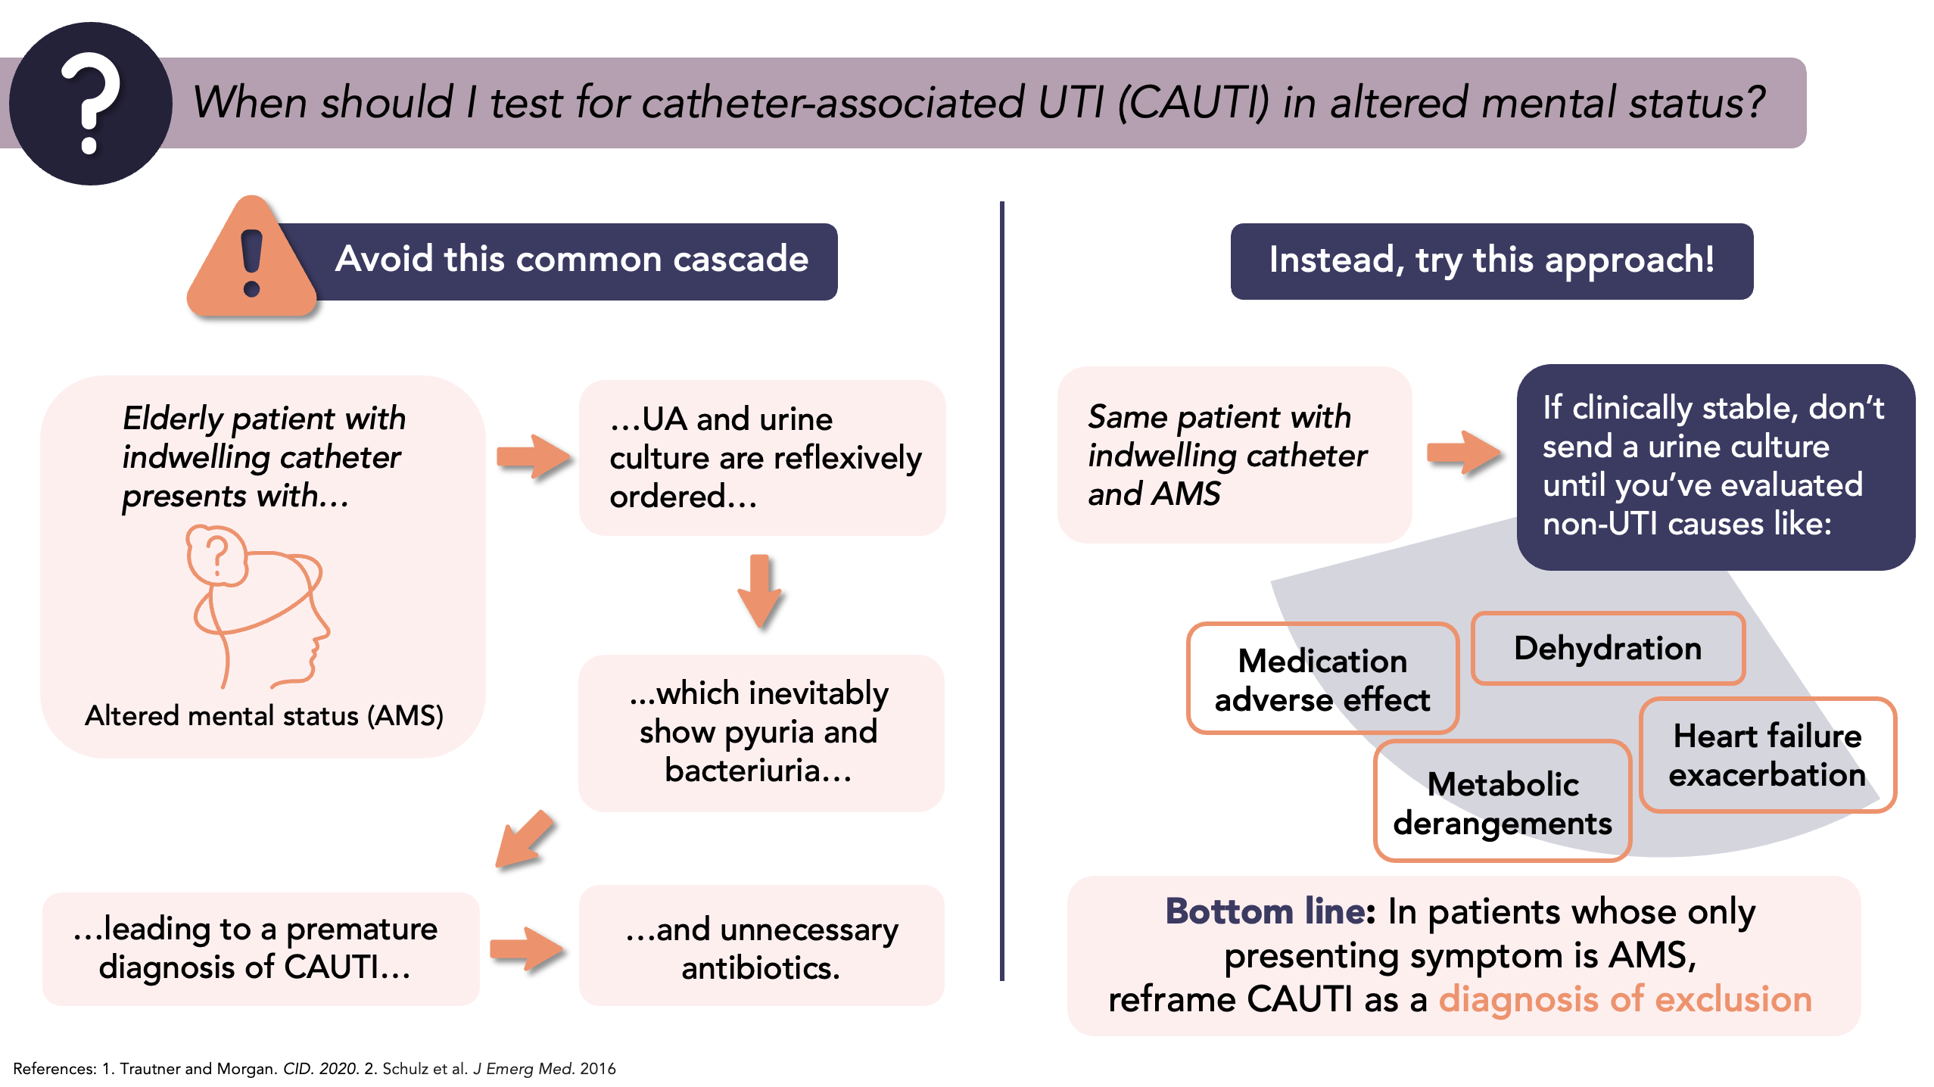

Slide 21
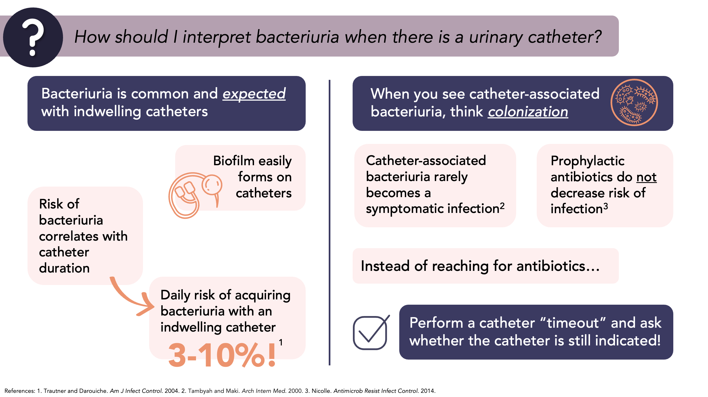

Slide 22
SSTI Guidelines for Empiric Antimicrobial Therapy
± TMP/SMX, clindamycin
Usual duration of therapy is 5 – 10 days
Stevens DL, et al. Clin Infect Dis. 2014;59(2):e10-52. Talan DA et al. N Engl J Med 2016;374:823-32. Daum RS et al. N Engl J Med 2017;376:2545-55.
Lake JG et al. Clin Infect Dis. 2020; 71::661-663
Notes:
Severe infection: patients who have failed incision and drainage plus oral antibiotics or those
with systemic signs of infection such as SIRS or immunocompromised patients.

Slide 23
A Simpler Perspective on SSTI
Cellulitis: Response to Rx
Fever
  50% defervesce within 24 h
  70% defervesce within 48 h
Erythema
  May increase for 24 hours
  50% decrease requires 3–4 days
Duration of Rx
Cellulitis
  5 (most cases) to 10 days
Necrotizing fasciitis
  Until further debridement not needed, and clinically stable for 48–72 hours
Culturable/purulent source
e.g., abscess, furuncle, wound
NO
YES
Empiric treatment with oxacillin or cefazolin
I&D, obtain cultures, empirically treat for MRSA
Discharge on dicloxacillin, cephalexin, etc.
Discharge on oral antibiotic based on susceptibility results
Stevens DL, et al. Clin Infect Dis. 2014;59(2):e10-52. Eron LJ et al. J Antimicrob Chemother. 2003 Nov;52 Suppl 1:i3-17. Eron LJ. Ann Intern Med. 2009 (1): ITC-1.
Jeng A, et al. Medicine (Baltimore). 2010; 89:217-226.

Slide 24
Real World Management of SSTI
Hospitalized Patients
34 VA Facilities 2016 – 2017
Non-purulent cellulitis
  Non-concordant MRSA Rx: 70%
  Non-concordant anti-pseudomonal Rx: 36%
Purulent cellulitis
  Non-concordant anti-pseudomonal Rx: 43%
Culture results
  5% positive for Enterobacterales
  3% positive for P. aeruginosa
48% received > 10 days of therapy
Sutton JD et al. Open Forum Infect Dis. 2020; 7:ofz554
Walsh T, et al. BMC Infect Dis 2016;16:721. Gibbons J, et al. Am J Infect Control 2017;45:1203. Jenkins T, et al. Infect Control Hosp Epidemiol. 2014;35(10):1241.
Notes:
34 VA sites – 2016-2017Unnecessary anti-pseudomonal therapy in VA MUE excluded patients with qSOFA >1 or on vasopressors
Inclusion:
First hospitalization within study period with SSTI ICD-10-CM code:
L02.X Cutaneous abscess, furuncle, carbuncle
L03.X Cellulitis and lymphangitis
Key exclusion:
Antibiotics for non-SSTI indication
Severe immunosuppression
Complicated SSTI*
Surgical site infection
Chronic wound infection
SSTI involving face
SSTI involving rectal or genital region
Human or animal-bite related SSTI
SSTI related to foreign bodies
Necrotizing SSTI
Deep tissue infection / involvemen
Transfer in or out of VA hospital
Mortality within 5 days

Slide 25
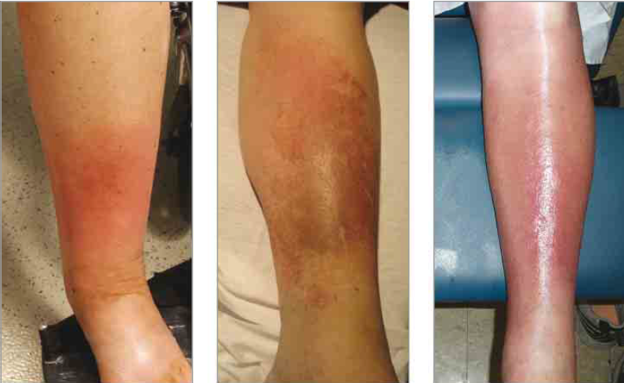
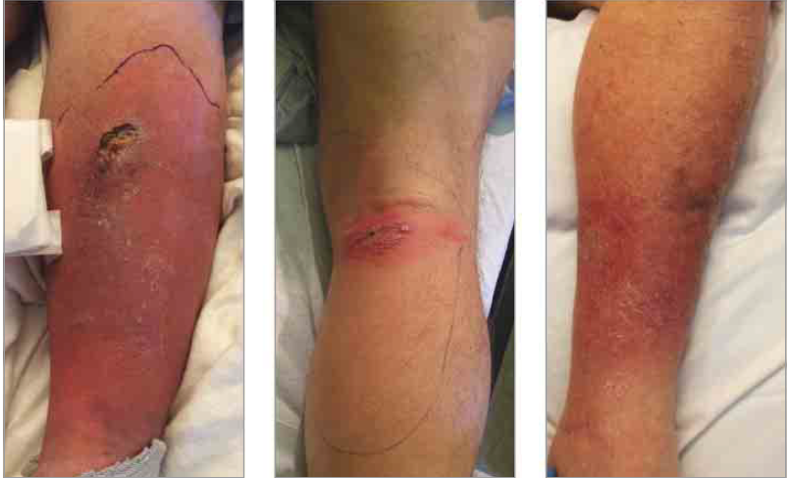
Mimics of Cellulitis
Deep venous thrombosis
Calciphylaxis
Stasis dermatitis
Incorrect Dx in up to 30% (inpt) - 90% (outpts)
Common
  Stasis dermatitis (cellulitis is RARELY bilateral)
  Contact dermatitis
  Thrombophlebitis
  Arthropod reactions
  Inflammatory tinea
Less common
  Drug eruption, erythema chronicum migrans, psoriasis, vasculitis, lymphedema, calciphylaxis, drug reactions, Sweet syndrome, foreign body granulomas, panniculitis,…
Hematoma
Erythema migrans
Cellulitis
Deresinki. Clin Infect Dis. 2016. 62: iii. Falagas ME. Ann Intern Med. 2005;142:47-55.
Raff AB, Kroshinsky D JAMA. 2016;316(3):325-337

Slide 26
Approach to Empiric Antibiotics for DFI
Mild
Subcutaneous involvement only
No SIRS criteria
Moderate
Deeper structure involvement OR
> 2 cm erythema & < 2 SIRS criteria
Severe
> 1 SIRS criteria
Indication for Pseudomonas treatment
Failed prior treatment
Life or limb-threatening infection
Immunocompromised
- MRSA colonization or infection in the past year
- Hemodialysis
Risk for MRSA
No
Yes
Some cases
Most cases
No
Yes
One of the following
Amoxicillin/clavulanate
Cephalexin
Cefadroxil
One of the following
Doxycycline
TMP-SMX
Clindamycin
- Ampicillin/sulbactam +/- vancomycin
OR
Ceftriaxone & metronidazole
+/- vancomycin
- Vancomycin & ceftriaxone
OR
- Vancomycin & ertapenem
- Vancomycin
AND & one of the following:
- Piperacillin/tazobactam
Cefepime
Meropenem
Empiric anti-pseudomonal therapy usually not necessary for severe infection; RCTs show
  Ampicillin/sulbactam equivalent to imipenem, included osteomyelitis; or pip/tazo (osteomyelitis excluded)
  Ertapenem equivalent to piperacillin/tazobactam – excluded osteomyelitis diagnosed by plain x-ray
  Moxifloxacin equivalent to piperacillin/tazobactam
Grayson ML et al. Clin Infect Dis. 1994; 18:683-693. Lipsky BA, et al. Clin Inf Dis. 2004; 38:17–24. Lipsky BA, et al. Lancet 2005; 366:1695-703. Lipsky BA et al. J Antimicrob Chemo.. 2007; 60:370-376. Young H, et al. OFID 2017. https://doi.org/10.1093/ofid/ofx016. Harless L, et al.. Surg Infections. 2005; 6:27-42.

Slide 27
Classification of Diabetic Foot Infections
Mild Diabetic Foot Infections
0.5 – 2.0 cm radius of erythema
AND at least two of:
Local swelling or induration
Local tenderness
Local increased warmth
Purulent discharge
AND
No other cause of a local inflammatory response
Moderate Diabetic Foot Infections
One or more of
2.0 cm radius of erythema
deep structures involved, e.g., tendon, bone
AND
< 2 SIRS criteria
Severe Diabetic Foot Infections
Any foot infection with > 1 SIRS criteria
2023 International Working Group on the Diabetic Foot Guidelines on the prevention and management of diabetes-related foot disease. www.iwgdfguidelines.org

Slide 28

Antibiotic Duration for Diabetic Foot Infections/Osteomyelitis
Bone/Joint Infection Extent | Antibiotic Duration
RESECTED (minimal remaining soft tissue infection) | 2-5 days
RESECTED Positive culture or histology of bone margins | 3 weeks
DEBRIDED (remaining soft tissue but not bone infection) | 1-2 weeks (mild) 2-4 wks (moderate/severe)
NO SURGERY/DEAD BONE | 6 weeks
International Working Group on the Diabetic Foot Infection Guidelines, 2023; https://doi.org/10.1093/cid/ciad527

Slide 29
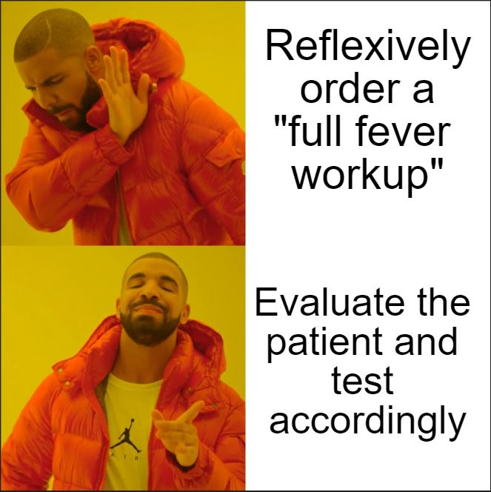
Say No To the “Full Fever Workup!
survey of UCLA IM residents, 2017
Howard-Anderson, J et al. Diagnosis (Berl) . 2019 Jun 26;6(2):157-163

Slide 30

Avoid the Sodium Sprinkle!
Heart failure patients w/o proven infection or x-ray evidence of pneumonia who received IV antibiotics
Had longer lengths of stay
Required more diuretics
Were more likely to be readmitted
Intravenous antibiotic (prepared in normal saline) | Na per day (mg)
Vancomycin* | 3540
Piperacillin-tazobactam* | 2560
Ampicillin-sulbactam | 2340
Meropenem | 1600
Cefazolin* | 1350
Cefepime* | 1170
Azithromycin* | 1000
Ceftriaxone* | 470
* Can also be diluted in D5W
Discontinue intravenous antibiotics or switch to oral antibiotics when indicated!
Frisbee J, et al. OFID 2019;6:ofz220; Wang N, et al. OFID 2019;6:ofz508

Slide 31
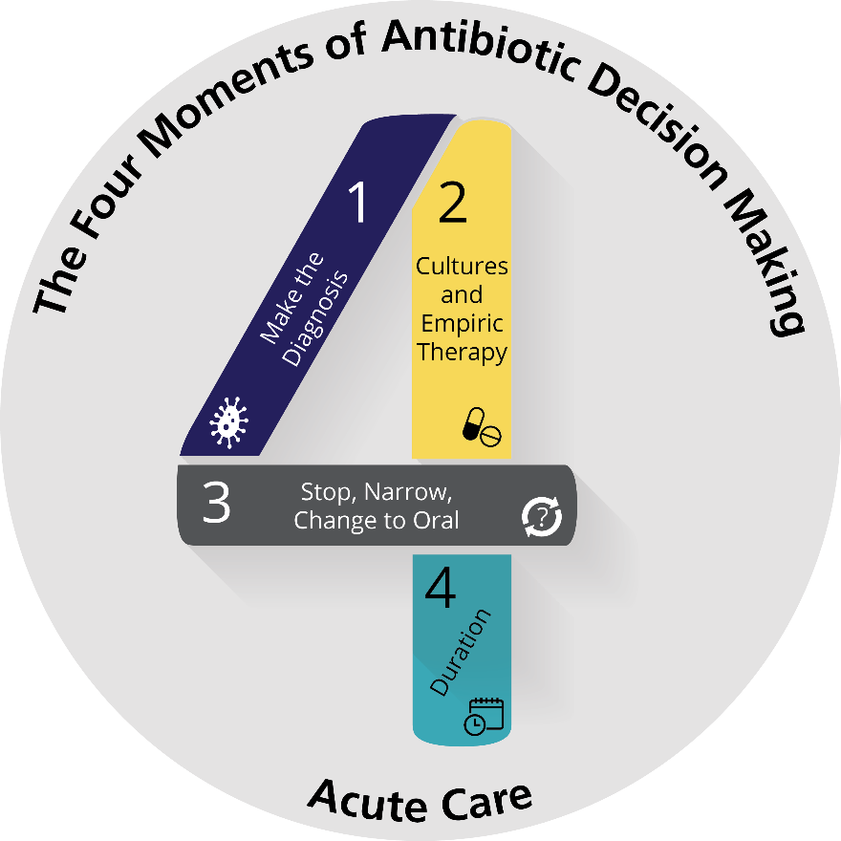
How Can Antibiotic Use Be Improved?
Diagnostic stewardship
  Unnecessary urine cx (e.g., routine ED urine culture, improper reflex urine culture)
  Untargeted “full fever work-up”
  Necessary cultures before antibiotics
Diagnostic thresholds – are antibiotics needed?
  UTI vs asymptomatic bacteriuria
  Pneumonia vs aspiration pneumonitis
  Cellulitis vs stasis dermatitis
Guideline concordant use of antibiotics
  Proper empiric therapy
    Limitation of MDRO therapy to at-risk patients
  Prompt de-escalation
  Appropriate duration of therapy
Figure provided by Pranita Tamma, M.D., M.H.S.

Slide 32
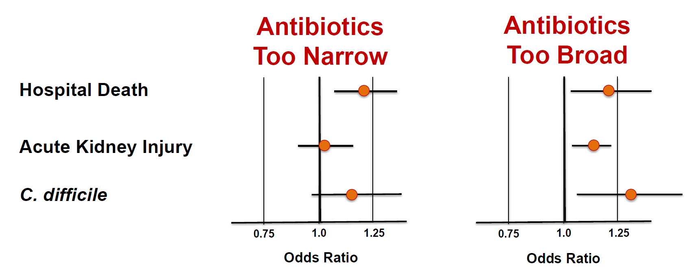
Overtreatment Potentially as Harmful as Undertreatment
17,430 patients with culture-positive sepsis on admission, 136 U.S. hospitals, 2009-2015
Rhee, JAMA Netw Open 2020;3(4):e202899

Slide 33

Know When to Hold Them & When to Fold Them
Certainty of Infection and Severity of Illness
High
Hold Antibiotics & Get More Data
(treat expeditiously if/when the data suggest infection)
Certainty of Infection
Give Antibiotics & Get More Data
(stop antibiotics if the data do not support infection)
Low
Low
HIgh
Severity of Illness

Slide 34
