Slide 1
Skin and Soft Tissue Infections

Slide 2
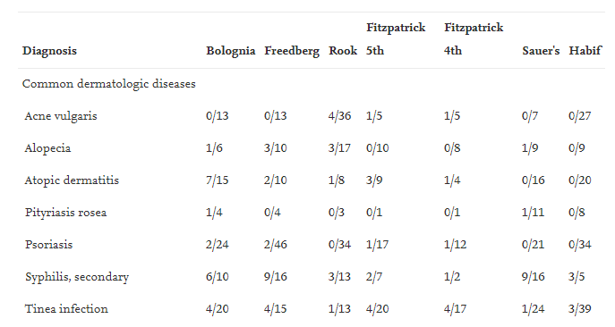
Bias in Dermatology Teaching Images
Teaching images in dermatology disproportionately depict white skin for all dermatologic diseases except STIs
47% of providers felt inadequately trained to diagnose skin disease in skin of color
A number of textbooks and digital resources are available with images of skin diseases in skin of color (https://www.visualdx.com/visualdx/7/)
Kelly AP, Taylor S, Lim HW, Serrano AM. Taylor and Kelly's Dermatology for Skin of Color, 2nd edn. New York, NY: McGraw-Hill Education/Medical, 2016.
Ebede T, Papier A; Journal of the American Academy of Dermatology; October 2006

Slide 3
Published Literature of Covid Dermatologic Findings
Lester JC, British Journal of Dermatology; May 2020

Slide 4
Published Literature of Covid Dermatologic Findings
Lester JC, British Journal of Dermatology; May 2020

Slide 5
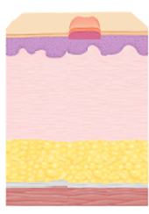
Outline
Review common skin and soft tissue infection syndromes
Describe the treatment options with a focus on outpatient management
Explore evidence for SSTI prevention and areas of controversy
Diabetic foot infection

Slide 6
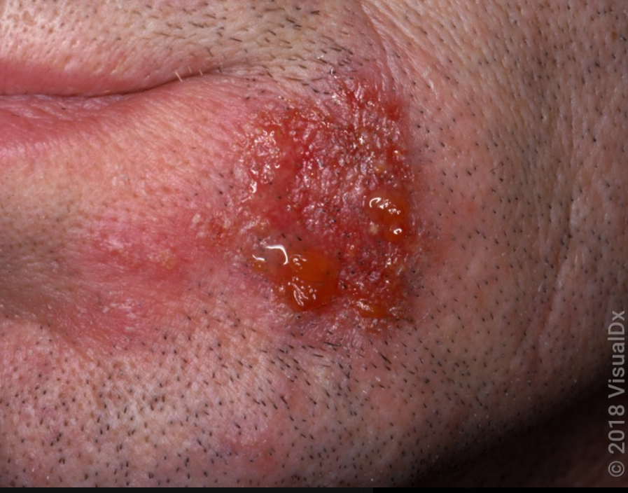
Question
A 35-year-old gentleman with a history of eczema who presents to the office with three days of an erythematous rash with crusting over his chin (pictured). He has a 3 year old child who had similar symptoms.
Which of the following is the most likely diagnosis:
A. Impetigo
B. Erysipelas
C. Cellulitis
D. Ecthyma
E. Erythema migrans

Slide 7
Question
A 35-year-old gentleman with a history of eczema who presents to the office with three days of an erythematous rash with crusting over his chin (pictured). He has a 3 year old child who had similar symptoms.
Which of the following is the most likely diagnosis:
A. Impetigo
B. Erysipelas
C. Cellulitis
D. Ecthyma
E. Erythema migrans

Slide 8
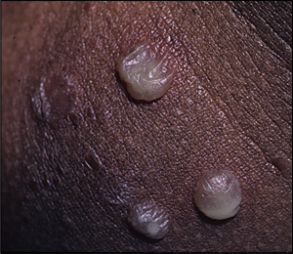
Impetigo
Most often Staph aureus and Group A Strep
Papules or vesicles -> honey colored crust, can be bullous or non-bullous
Person to person spread is commonly seen and small epidemics can occur in crowded environments (Contact precautions recommended until on therapy x24 hours)
Diagnosis based on symptoms and clinical assessment
Cole C, Gazewood J. Diagnosis and treatment of impetigo. Am Fam Physician. 2007;75(6):862.
Notes:
Superficial infection of the epidermis due to staph and strep. Post strep complications are uncommon, the strains for impetigo do not usually cause glomerulonephritis (this strain is more common in strep pharyngitis)
Bullous impetigo more often due to staph aureus with exfoliative toxins that cause loss of cell adhesion in the superficial epidermis
Retapamulin was approved in 2007 (first new topical antibiotic in 20 years), works on protein synthesis

Slide 9
Impetigo Treatment
Impetigo is usually self-limited with warm water to remove crusting, however treatment is generally recommended
Reduces spread of infection and hastens resolution
Uncertain impact on risk of post-strep glomerulonephritis
If few lesions topical mupirocin or retapamulin are first line agents
OTC antibiotic ointments may be effective (ie Neosporin) but carries risk of contact dermatitis
Widespread infection may require oral antibiotics directed at Group A Strep and MSSA - Cephalexin/Cefadroxil or Dicloxacillin x7 days

Slide 10
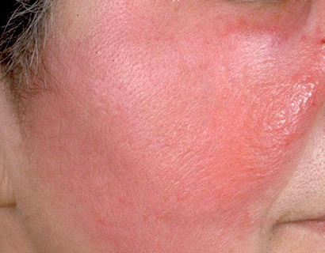
Question
You see a 48 year old lady who presents with one day of a red, painful rash over her right cheek (see picture). On exam her vitals are WNL, the rash is tender to palpation and warm to the touch with enlarged preauricular lymph nodes. There is no involvement of the eyelids and no pain with extraocular movement
What is the most appropriate next step in management?
A. Start amoxicillin
B. Send a skin culture and start Cefadroxil
C. Obtain MRI orbit
D. Obtain a punch biopsy
C. Send ESR, CRP, ANA, and dsDNA

Slide 11
Question
You see a 48 year old lady who presents with one day of a red, painful rash over her right cheek (see picture). On exam her vitals are WNL, the rash is tender to palpation and warm to the touch with enlarged preauricular lymph nodes. There is no involvement of the eyelids and no pain with extraocular movement
What is the most appropriate next step in management?
A. Start amoxicillin
B. Send a skin culture and start Cefadroxil
C. Obtain MRI orbit
D. Obtain a punch biopsy
C. Send ESR, CRP, ANA, and dsDNA

Slide 12
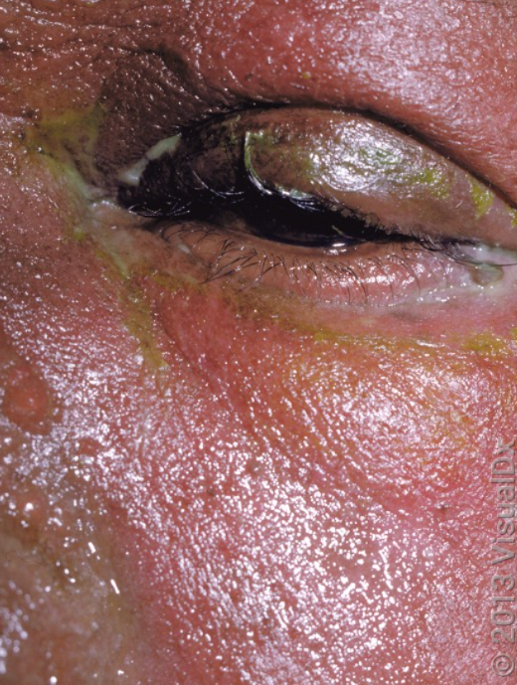
Erysipelas
Infection restricted to the dermis
Often lesions are raised, salmon red, with clear lines of demarcation
Almost all cases are due to Group A Strep
Gold standard for diagnosis is punch biopsy, rarely done and diagnosed clinically

Slide 13
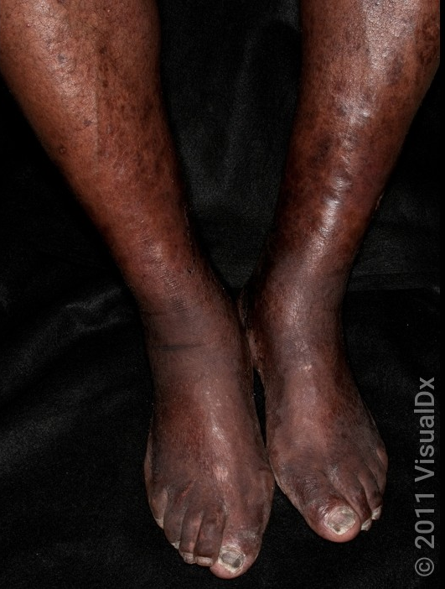
Question
A 58-year-old gentleman with a history of HFrEF and DM who presents with bilateral lower extremity pain and hyperpigmentation x 4 weeks. He was given a 1 week course of Keflex without response. What is the likely microbiologic etiology of his rash?
A. Staph aureus
B. Strep pyogenes
C. Strep dysgalatiae
D. Pseudomonas
E. None

Slide 14
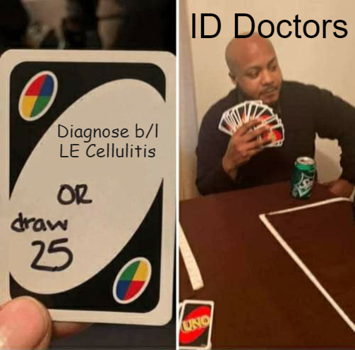
Question
A 58-year-old gentleman with a history of HFrEF and DM who presents with bilateral lower extremity pain and hyperpigmentation x 4 weeks. He was given a 1 week course of Keflex without response. What is the likely microbiologic etiology of his rash?
A. Staph aureus
B. Strep pyogenes
C. Strep dysgalatiae
D. Pseudomonas
E. None

Slide 15
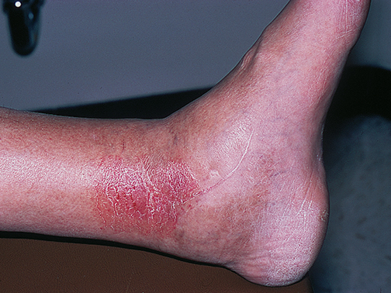
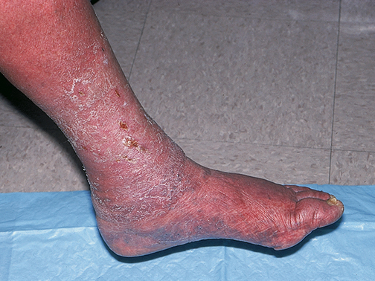
Mimic Alert
Stasis dermatitis
The result of chronic venous hypertension
Can results in erythema, scaling, and ulceration
Often involves the medial supramalleolar region but can extend beyond this in chronic disease
Can mimic cellulitis but usually develops over weeks to months and is often bilateral
Can become secondarily infected

Slide 16
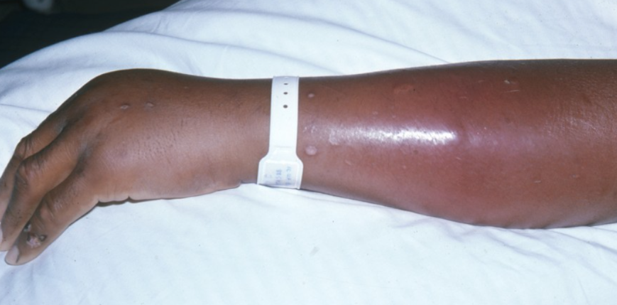
Cellulitis
Infection that extends deeper than erysipelas and involves subcutaneous tissue
Because infection extends deeper the borders are less well demarcated
Etiologic agents are Staph aureus, Group A Strep, and other Beta-hemolytic strep
Often preceded by break in the skin by either trauma (as minor as shaving) or underlying skin diseasze

Slide 17
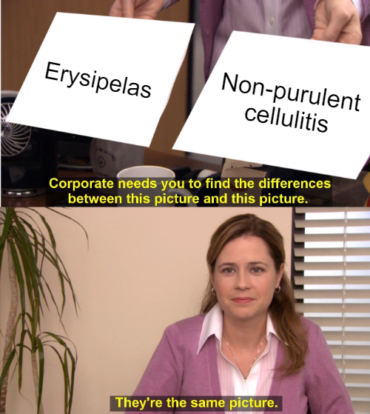
Management
Purulence or no purulence?
If erysipelas or non-purulent cellulitis target Strep and MSSA
Exception if systemically ill, history of MRSA infections, or overlying an indwelling device
2 Trials compared cephalexin plus placebo versus cephalexin plus TMP/SMX for treatment of non-purulent cellulitis
Study of 500 participants cure in 85.5% cephalexin only versus 83.5 in combo group¹
Study of 146 patricipants showed 82% cured in cephalexin only versus 85% in combo group²
Moran GJ, Krishnadasan A, Mower WR, et al. Effect of Cephalexin Plus Trimethoprim-Sulfamethoxazole vs Cephalexin Alone on Clinical Cure of Uncomplicated Cellulitis: A Randomized Clinical Trial. JAMA 2017; 317:2088
Pallin DJ, Binder WD, Allen MB, et al. Clinical trial: comparative effectiveness of cephalexin plus trimethoprim-sulfamethoxazole versus cephalexin alone for treatment of uncomplicated cellulitis: a randomized controlled trial. Clin Infect Dis 2013; 56:1754
Notes:
No fun or snazzy names

Slide 18
Purulent Cellulitis Management
If purulent, MRSA and MSSA are the dominant organisms to target
Reasonable, but not necessary, to culture any purulent discharge and empirically cover MRSA
Options include Clindamycin (71% susceptible), TMP-SMX (94% susceptible), or Doxycycline (86% susceptible)
Other oral agents include linezolid, delafloxacin, and omadacycline but generally try to preserve these agents

Slide 19
Duration
In general, duration of 5-6 days is sufficient if there’s initial response to therapy but may need to be extended if severe infection or slow response
Not a ton of data on duration for cellulitis and guidelines are based on expert opinion
Study of 87 participants with non-purulent cellulitis compared 5 to 10 days of Levofloxacin and found 98% cure rate in both arms
ESTABLISH-1 trial compared 6 days of Tedizolid to 10 day of Linezolid and found80% cure rate in both groups
Dutch study of 151 participants with severe cellulitis (purulent and non-purulent) compared 6 to 12 days of flucloxacillin and found a 73.1% cure rate and 6% 90-day relapse rate in the 12-day group and 67.1% cure rate and 24% 90-day relapse rate in 6-day group
No studies looking at duration specifically for TMP/SMX, doxycycline, clindamycin, cephalexin or amoxicillin
Hepburn MJ, Dooley DP, Skidmore PJ, Ellis MW, Starnes WF, Hasewinkle WC. Comparison of short-course (5 days) and standard (10 days) treatment for uncomplicated cellulitis. Arch Intern Med 2004; 164(15): 1669-74.
https://jamanetwork.com/journals/jama/fullarticle/1570280
Cranendonk et al. Antibiotic treatment for 6 days versus 12 days in patients with severe cellulitis: a multicentre randomised, double-blind, placebo-controlled, non-inferiority trial. Clin Microbiol Infect 2019; 26(5):606-612.

Slide 20
Question
You evaluate a 33 year old gentleman with a history of injection drug use presents to the office with a painful lump over his right arm that has developed over the last 3 days. There is no overlying erythema. On exam he has normal vital signs with warmth, tenderness, and a 3cm fluctuant collection palpable over his right forearm.
What is the most appropriate next step in management?
A. I&D alone
B. I&D and start TMP-SMX
C. I&D and start amoxicillin
D. Reassure and advise warm compresses
E. Refer to Dermatology

Slide 21
Question
You evaluate a 33 year old gentleman with a history of injection drug use presents to the office with a painful lump over his right arm that has developed over the last 3 days. There is no overlying erythema. On exam he has normal vital signs with warmth, tenderness, and a 3cm fluctuant collection palpable over his right forearm.
What is the most appropriate next step in management?
A. I&D alone
B. I&D and start TMP-SMX
C. I&D and start amoxicillin
D. Reassure and advise warm compresses
E. Refer to Dermatology

Slide 22
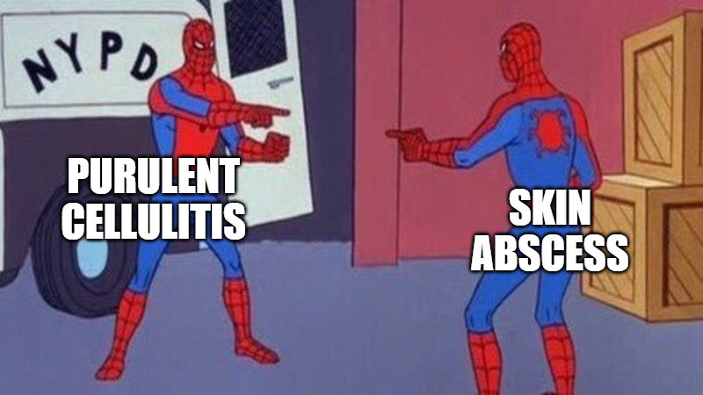
Skin Abscess
Microbiology of skin abscess is similar to purulent cellulitis, mostly MSSA and MRSA
I&D is the cornerstone of management
Role of empiric antibiotics has changed over time:
IDSA SSTI guidelines last updated 2014- recommended I&D alone for abscess without associated systemic signs of infection
Two recent trials have suggested benefit to
antibiotic use for mild skin abscesses

Slide 23
Skin Abscess antibiotics
1265 participants with skin abscess > 2 cm large randomized to I&D alone or I&D plus TMP-SMX for 7 days. Cure 14 days after I&D was 73.6% in the I&D alone group compared to 80.5% in the I&D plus TMP-SMX group. Absolute risk reduction 6.9% [95% CI 2.1-11.7%] ¹
DMID 07-0051 trial: 786 participants with skin abscess <5 cm randomized (half were <2cm) to I&D alone or I&D plus 10 days of TMP-SMX. Cure at 17 days after I&D was 68.9% in the I&D alone group compared to 81.7% in the I&D plus TMP-SMX group. Absolute risk reduction 12.8% [95% CI 6.4-22.0%]²
Talan DA, Mower WR, Krishnadasan A, et al. Trimethoprim-Sulfamethoxazole versus Placebo for Uncomplicated Skin Abscess. N Engl J Med 2016; 374:823.
Daum RS, Miller LG, Immergluck L, et al. A Placebo-Controlled Trial of Antibiotics for Smaller Skin Abscesses. N Engl J Med 2017; 376:2545.

Slide 24
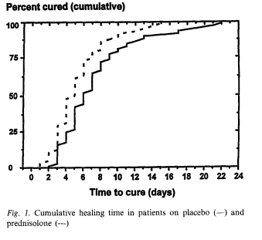
Controversy!
Steroids and NSAIDs
Cellulitis is a paucibacillary disease with low bacterial load on punch biopsies from involved areas
Clinical manifestations the result of a strong inflammatory response
A study of 112 participants found an eight-day course of prednisolone hastened clinical resolution by a day¹
Two studies of NSAIDs showed 80% of participants receiving NSAIDs showed clinical improvement within 48 hours compared to 32% of those receiving placebo^{2,3}
Theoretical concern is masking deeper infection leading to delayed diagnosis of life-threatening complications
Practice patterns vary
Dall L, Peterson S, Simmons T, Dall A. Rapid resolution of cellulitis in patients managed with combination antibiotic and anti-inflammatory therapy. Cutis 2005; 75:177.
Davis JS, Mackrow C, Binks P, et al. A double-blind randomized controlled trial of ibuprofen compared to placebo for uncomplicated cellulitis of the upper or lower limb. Clin Microbiol Infect 2017; 23:242.
Bergkvist PI, Sjöbeck K. Antibiotic and prednisolone therapy of erysipelas: a randomized, double blind, placebo-controlled study. Scand J Infect Dis 1997; 29:377.

Slide 25
Question
All of the following have been shown to reduce the rate of recurrent SSTI except:
A. Long term antibiotic prophylaxis
B. Lower Extremity Compression Stockings
C. Staph decolonization
E. Treatment of ipsilateral tinea pedis
D. None of the above

Slide 26
Question
All of the following have been shown to reduce the rate of recurrent SSTI except:
A. Long term antibiotic prophylaxis
B. Lower Extremity Compression Stockings
C. Staph decolonization
E. Treatment of ipsilateral tinea pedis
D. None of the above

Slide 27
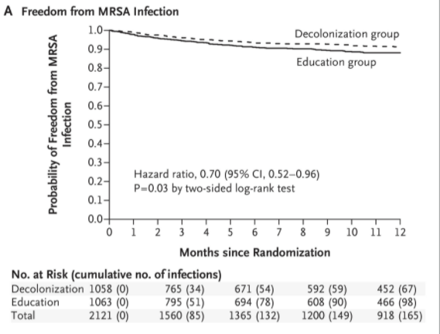
Prevention – Staph decolonization
Project CLEAR Trial¹
2121 participants who were MRSA nares colonized or had admission with MRSA infection
Randomized to decolonization with daily chlorhexidine bath/shower plus chlorhexidine mouthwash and 2% nasal mupirocin BID x5 days twice a month for 6 months versus placebo
At 1 year 9.2% in placebo group had a MRSA infection compared to 6.3% in decolonization group
No difference in rates of Skin and Soft Tissue Infection (largest reductions seen in LRI and surgical site infections)
Other studies have shown decolonization can reduce rates of colonization but haven’t demonstrated decreases in rates of SSTI
Still often offer to patients with recurrent MRSA SSTI
Huang SS, Singh R, McKinnell JA, et al. Decolonization to Reduce Postdischarge Infection Risk among MRSA Carriers. N Engl J Med 2019; 380:638.

Slide 28
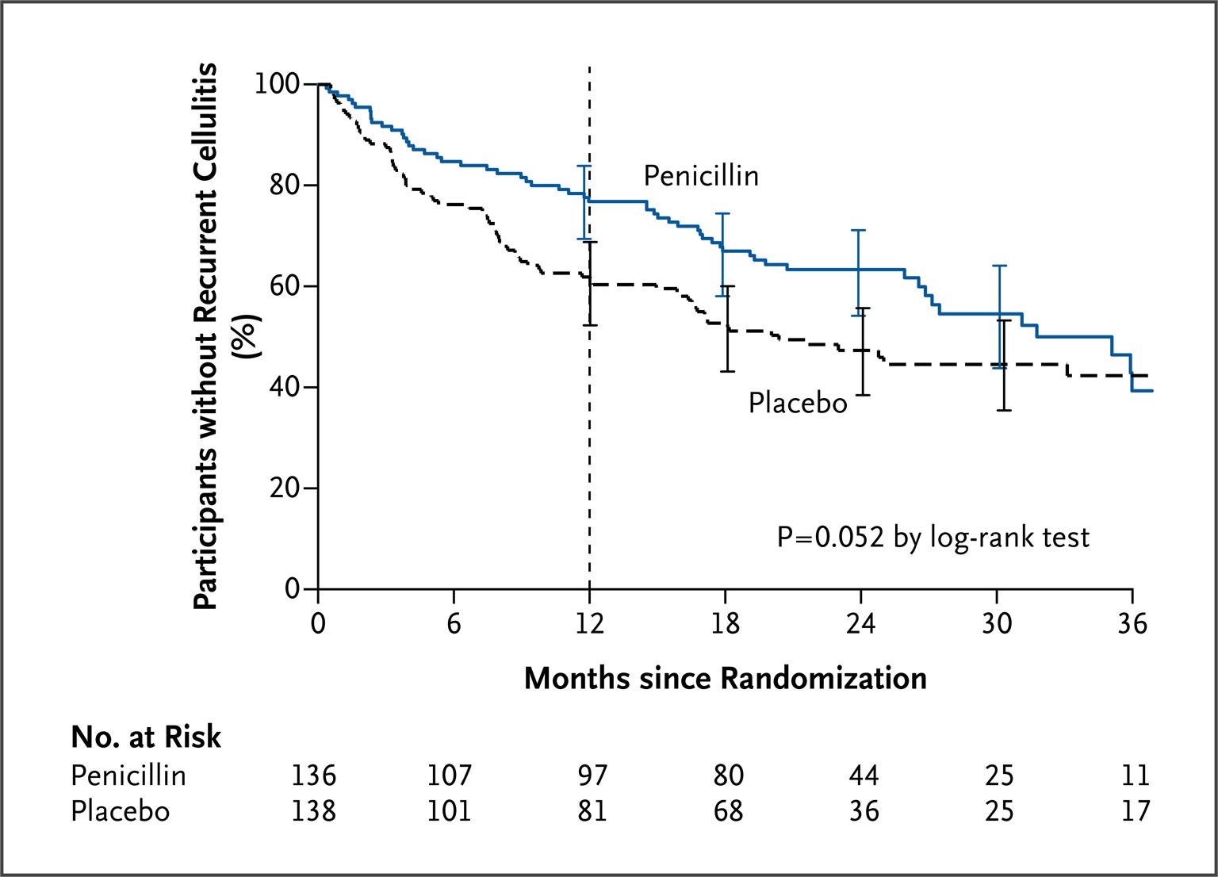
Prevention - Antibiotics
PATCH I Trial
274 participants with 2 or more episodes of lower extremity cellulitis within the preceding 3 years
Randomized to penicillin (250mg PO BID) or placebo for 1 year
37% in placebo group had recurrence within a year
22% in the penicillin group had recurrence within a year
15% risk reduction [95% CI 4-26%], NNT 6.7 but protective effect diminishes when PCN stopped
Other work has shown this is a cost-effective intervention, in general considered in patients with 3+ episodes per year
https://www.nejm.org/doi/full/10.1056/nejmoa1206300

Slide 29
Prevention - Stockings
2020 NEJM study of compression stockings in patients with LE edema and 2 or more episodes of cellulitis in the preceding 2 years
Trial stopped early, observed a 25% risk reduction, NNT = 4 (!)
In general should start compression therapy after resolution of cellulitis
https://www.nejm.org/doi/full/10.1056/NEJMoa1917197

Slide 30
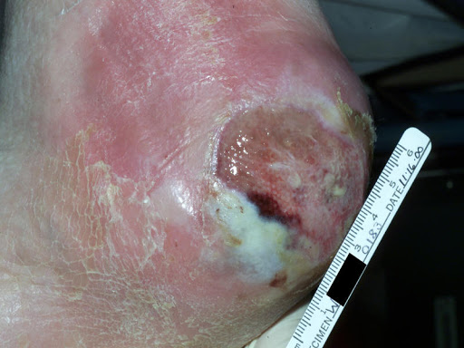
The Diabetic Foot: What Constitutes Evidence of Infection?
At least two of the following:
Local swelling or induration
Erythema
Local tenderness or pain
Local warmth
Purulent discharge (thick, opaque to white or sanguinous secretion)
Exclude other causes of an inflammatory response of the skin (e.g. trauma, gout, acute Charcot neuro-osteoarthropathy, fracture, thrombosis, venous stasis)
Lipsky BA, et al. IDSA GL CID 2012;54(12):132-73

Slide 31
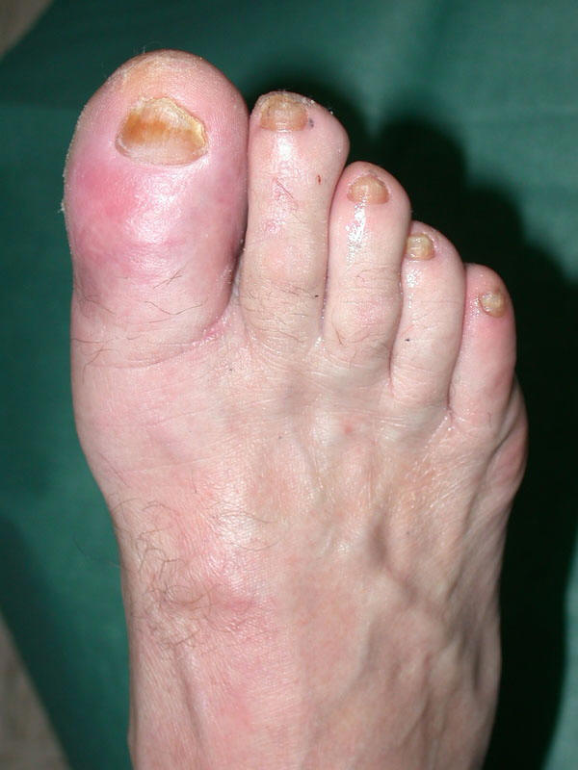
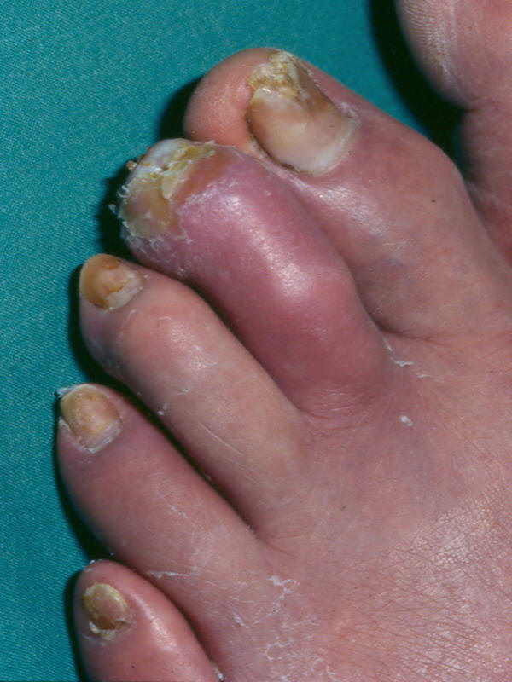
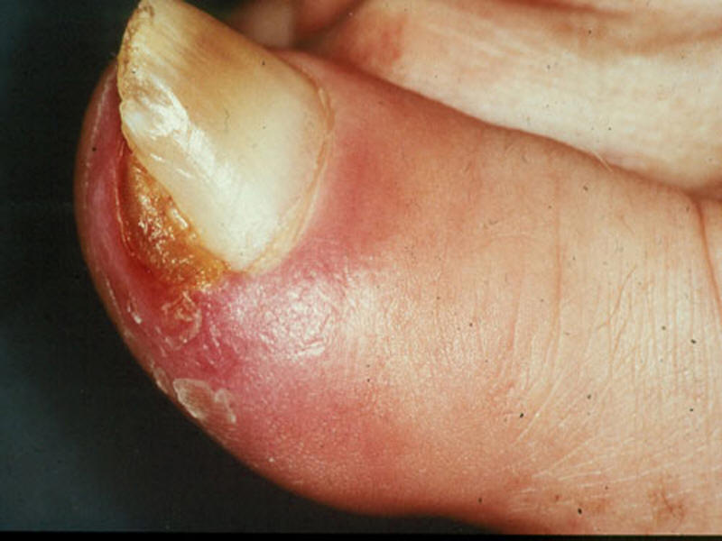
Mild Diabetic Foot Infection
Local infection involving only the skin and the subcutaneous tissue (without involvement of deeper tissues). If erythema, must be >0.5 cm to ≤2 cm around the ulcer.
No systemic toxicity, as defined by greater than 1 of the following:
Temperature > 38°C or < 36°C
Heart rate > 90
Respiratory rate > 20 or PaCO2 < 32
WBC > 12,000 or < 4,000, or ≥ 10% bands
Oral antibiotics and outpatient management are typically appropriate
Lipsky BA, et al. IDSA GL CID 2012;54(12):132-73; antimicrobe.org

Slide 32
Oral Antimicrobial Therapy Options
Amoxicillin-clavulanate 500-875mg po bid
Cefadroxil 500-1000mg po bid: particularly if no purulence is present or cultures grow strep or MSSA
Doxycycline 100mg po bid, TMP-SMX 1 DS tab po bid, or clindamycin 300mg po tid (if concern for or cultures grow MRSA)
Levofloxacin 500mg po qd plus metronidazole 500mg po tid
Treatment duration can be variable. Serial ESR/CRP can be helpful, but key is improvement of signs/symptoms (don’t necessarily need to treat until all are gone but they should be getting there)

Slide 33
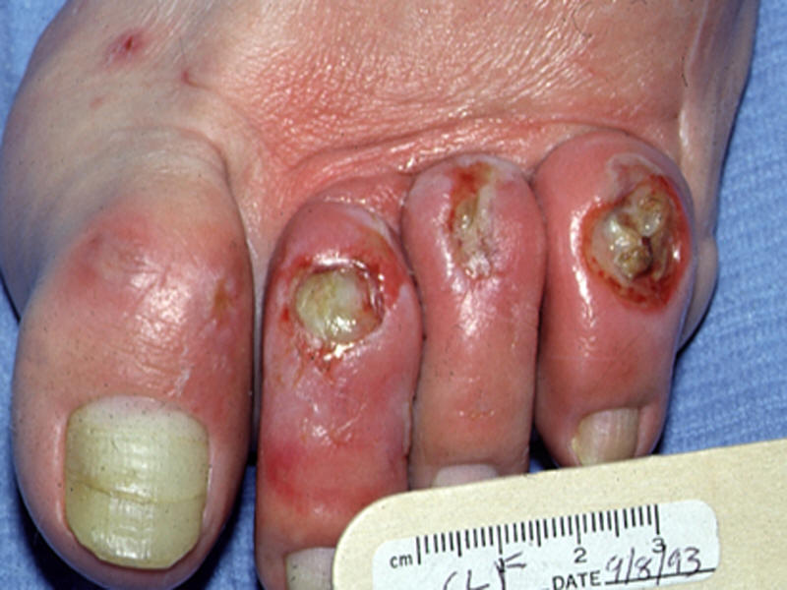
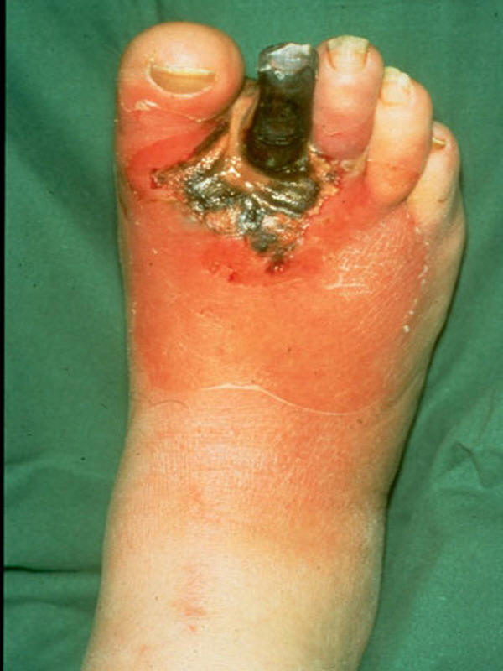
Moderate Diabetic Foot Infection
Local infection with erythema >2 cm around the ulcer OR involving structures deeper than skin and subcutaneous tissues (e.g, abscess, osteomyelitis, septic arthritis, fasciitis), BUT
NO systemic toxicity, as defined by greater than 1 of the following:
Temperature > 38°C or < 36°C
Heart rate > 90
Respiratory rate > 20 or PaCO2 < 32
WBC > 12,000 or < 4,000, or ≥ 10% bands
Lipsky BA, et al. IDSA GL CID 2012;54(12):132-73; antimicrobe.org

Slide 34
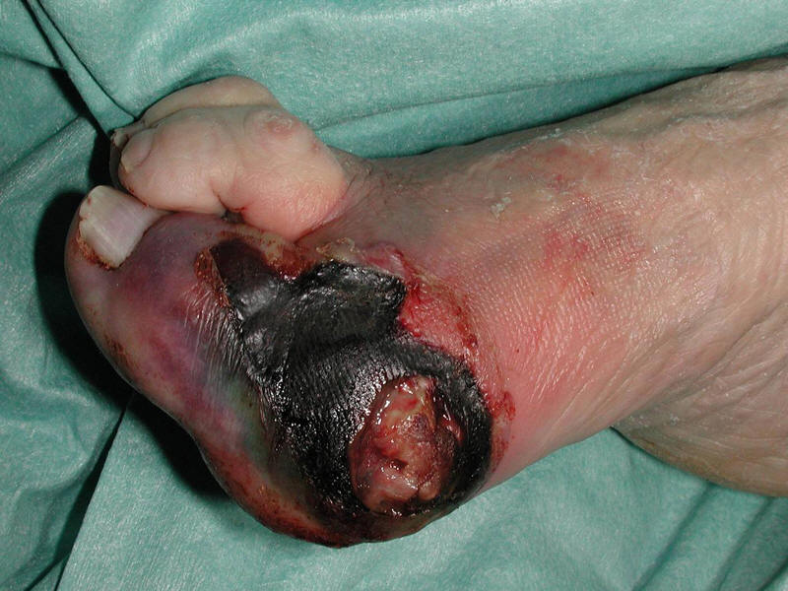
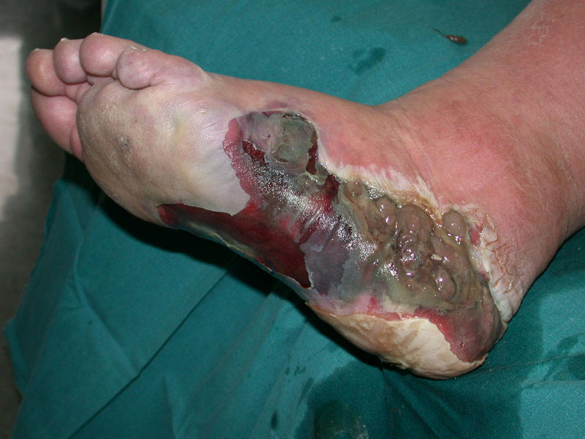
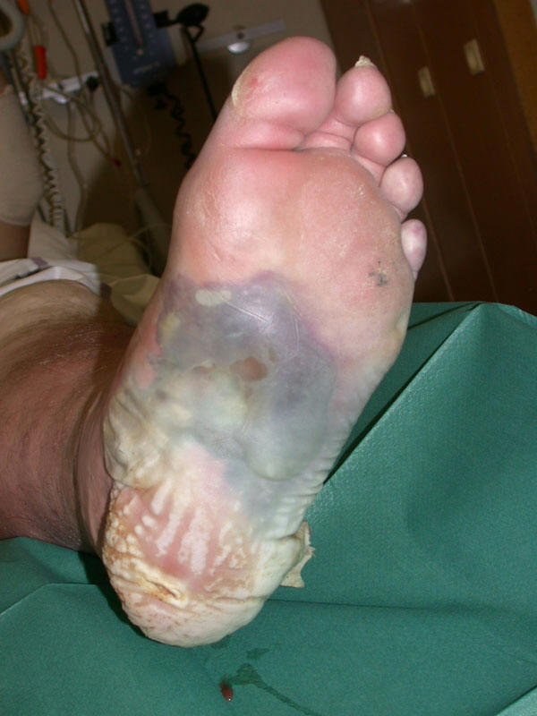
Severe Diabetic Foot Infection
Local infection with erythema >2 cm around the ulcer OR involving structures deeper than skin and subcutaneous tissues (e.g, abscess, osteomyelitis, septic arthritis, fasciitis), AND
Systemic toxicity, as defined by greater than 1 of the following:
Temperature > 38°C or < 36°C
Heart rate > 90
Respiratory rate > 20 or PaCO2 < 32
WBC > 12,000 or < 4,000, or ≥ 10% bands
Lipsky BA, et al. IDSA GL CID 2012;54(12):132-73; antimicrobe.org

Slide 35
Empiric Inpatient Rx of DFI: GLA Approach
Non-ICU, emergent surgical intervention not required
Ampicillin-sulbactam PLUS vancomycin OR
Ceftriaxone (+/- metronidazole) PLUS vancomycin
Severe disease (systemically ill, emergent surgery)
Ertapenem PLUS vancomycin
Life- or limb-threatening disease
Piperacillin-tazobactam or meropenem PLUS vancomycin

Slide 36
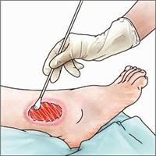
The Culture of Culturing in DFI
Very institution-dependent!
Don’t culture (or interpret a culture from) a wound that doesn’t appear infected!
Superficial swabs don’t correlate well with bone cultures
Hell hath no fury like an orthopedic surgeon asked to do a bone biopsy
Podiatry typically amenable to sending “deep cultures” with initial debridement; this tends to work well at GLA

Slide 37
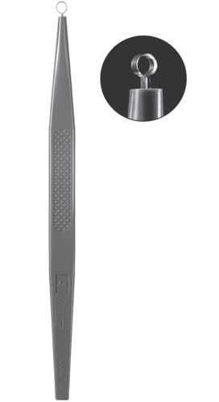
So Just What Is A “Deep Culture?”
Obtained by biopsy or curettage* (preferably not swab)
Performed after the wound has been cleansed and debrided
Can also aspirate purulent secretions using sterile needle or syringe
Send promptly; don’t let it sit out
Anaerobic and aerobic transport media (or just anaerobic if you can only pick one)
*: the scraping of tissue from the ulcer base using a dermal curette or sterile scalpel blade

Slide 38
Interpreting “Deep Cultures”
Gram-positive cocci (esp. S. aureus, gp B strep) are probably pathogenic
Gram-negative bacilli are often NOT pathogenic (though if they persist in an infection not responding to Gram-positive-directed therapy, they may be)

Slide 39
Questions?

